Slide 1
LECTURE 3
Review last lecture
Stack & Queue
Subroutine
Notes:
Supeno Djanali - Teknik Informatika-FTIf

Slide 2


Slide 3
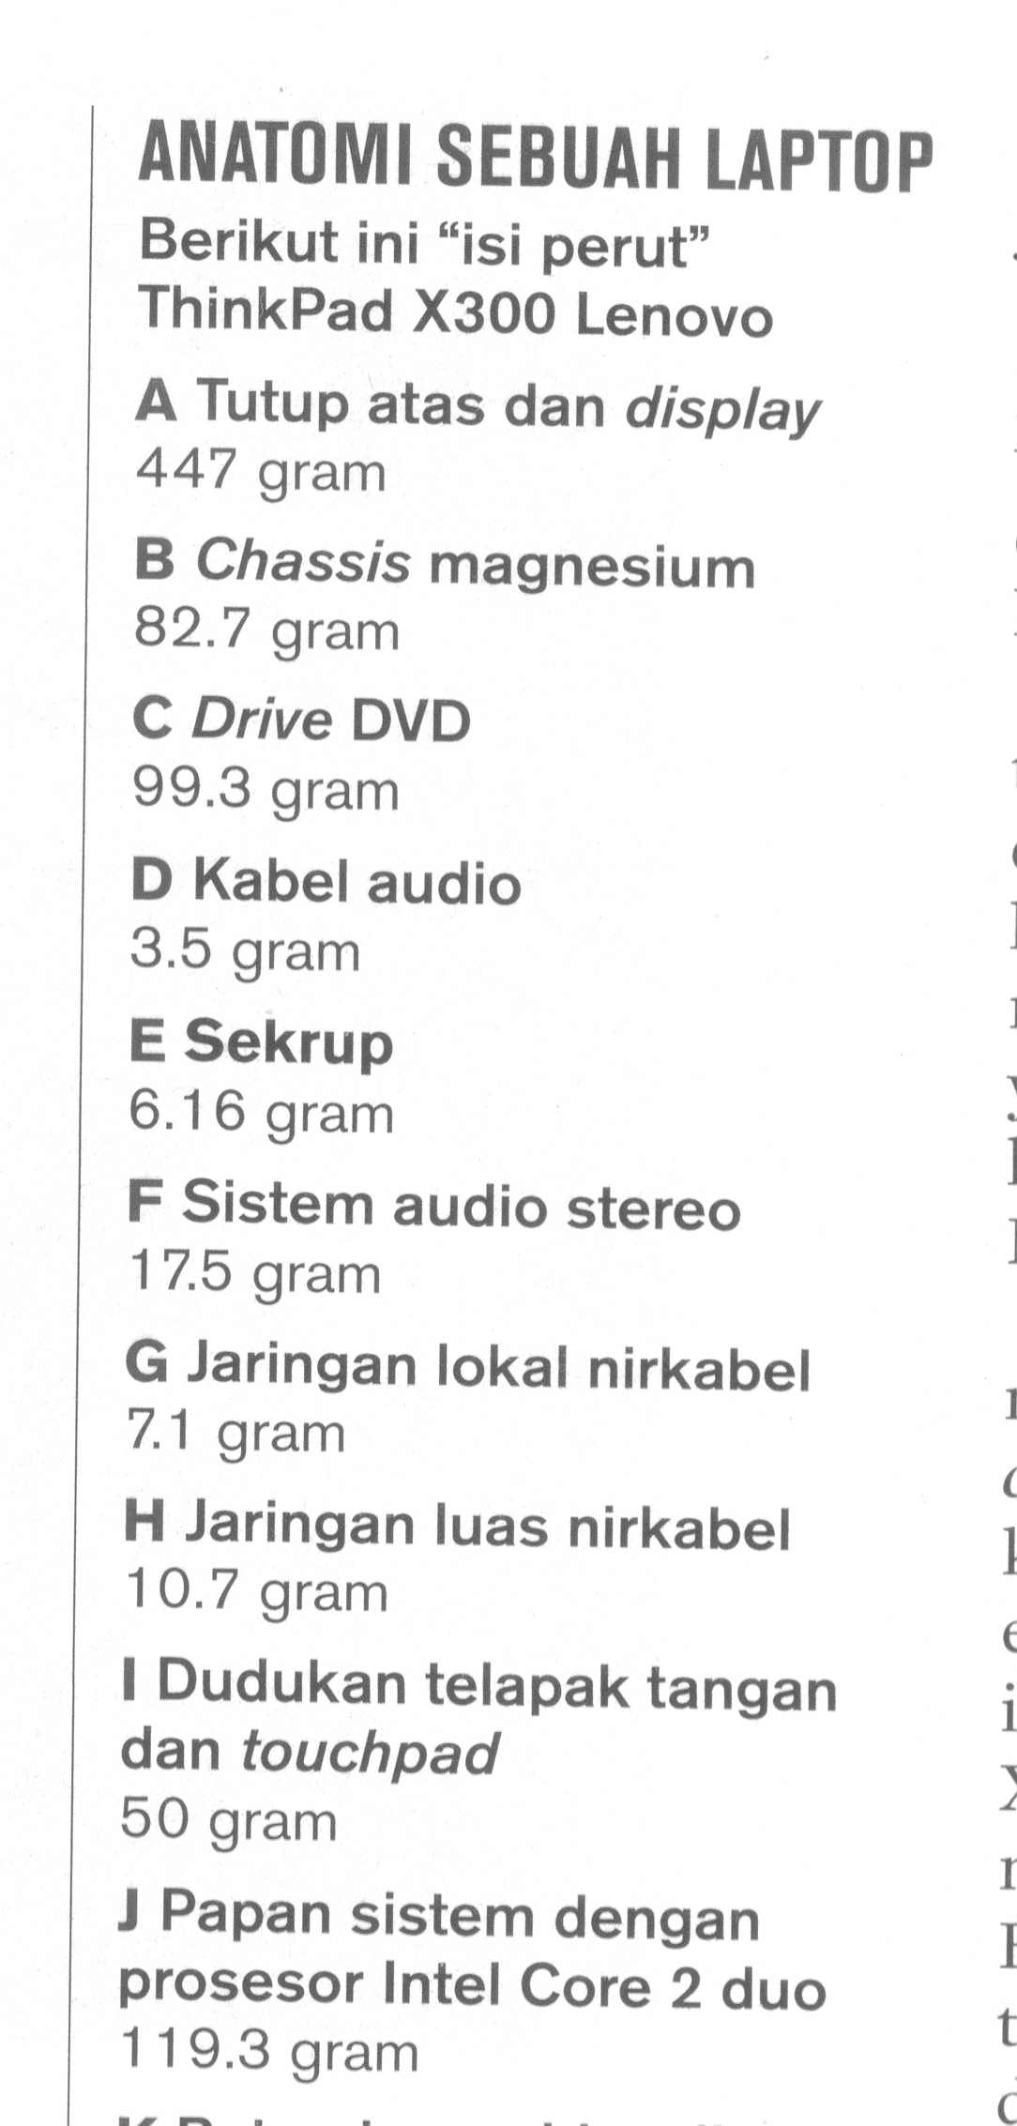
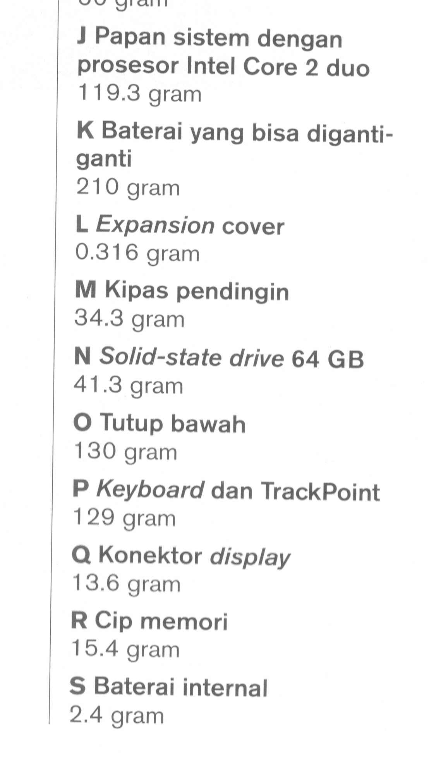

Slide 4
Generic Addressing Modes
Name | Assembler syntax | Addressing function
Immediate | #Value | Operand = Value
Register | Ri | EA = Ri
Absolute (Direct) | LOC | EA = LOC
Indirect | (Ri) | EA = [Ri]
 | (LOC) | EA = [LOC]
Index | X(Ri) | EA = [Ri] + X
Base with index | (Ri,Rj) | EA = [Ri] + [Rj]
Base with index and offset | X(Ri,Rj) | EA = [Ri] + [Rj] + X
Relative | X(PC) | EA = [PC] + X
Autoincrement | (Ri)+ | EA = [Ri] ; increment Ri
Autodecrement | -(Ri) | Decrement Ri ; EA = [Ri]
EA = Effective Address

Slide 5
What is this program doing?
Load R2,N
Clear R3
Move R4,#NUM1
LOOP Add R3,(R4)
Add R4,#4
Decrement R2
Branch>0 LOOP
Store R3,SUM

Slide 6
HOW ABOUT THIS
Load R2,N
Clear R3
Move R4,#NUM1
LOOP: Load R5, (R4)
Add R3, R3, R5
Add R4, R4, #4
Subtract R2, R2, #1
Branch_IF_[R2]>0 LOOP
Store R3,SUM

Slide 7
CONDITION CODES
Processor always checks the result of every operation to be used for branching. This is done by storing the result in special bits as condition code flags. These flags are stored in special register: condition code register or status register.
Four flags that often used are:
N (Negative) = 1 if the result of operation is negative
Z (Zero) = 1 if the result of operation is 0
V (Overflow) = 1 if overflow
C (Carry) = 1 if ther is carry

Slide 8
What is this program doing?
    Move R0,#LIST
    Clear R1
    Clear R2
    Clear R3
    Load R4,N
    LOOP Add R1, 4(R0)
    Add R2,8(R0)
    Add R3,12(R0)
    Add R0,#16
    Decrement R4
    Branch >0 LOOP
    Store R1,SUM1
    Store R2,SUM2
    Store R3,SUM3
N | n
LIST | NRP Mhs
LIST+4 | Tes1
LIST+8 | Tes2
LIST+12 | Tes3
LIST+16 | NRP Mhs
 | Tes1
 | Tes2
 | Tes3
 | ……

Slide 9
ASSEMBLY LANGUAGE
START | 100 | Load | R1,N
 | 104 | Move | R2,#NUM1
 | 108 | Clear | R0
LOOP | 112 | Add | R0,(R2)
 | 116 | Add | R2,#4
 | 120 | Decrement | R1
 | 124 | Branch >0 | LOOP
 | 128 | Store | R0,SUM
 | 132
 |  | …….
SUM | 200
N | 204 | 100
NUM1 | 208
NUM2 | 212
 |  | …….
NUMn | 604
SUM | EQU | 200
 | ORIGIN | 204
N | DATAWORD | 100
NUM1 | RESERVE | 400
 | ORIGIN | 100
START | LOAD | R1,N
 | MOVE | R2,#NUM1
 | CLR | R0
LOOP | ADD | R0,(R2)
 | ADD | R2,#4
 | DEC | R1
 | BGTZ | LOOP
 | STORE | R0,SUM
 | RETURN
 | END | START

Slide 10
STACKS
Stack is a LIFO (Last In First Out) data structure
Its operation: PUSH & POP
 |  | …
 | SP | 502
 |  | -111
 |  | 69
 |  | …
 |  | 1948
 | Ri | 2008
 |  | …
 | SP | 2008
 |  | 502
 |  | -111
 |  | 69
 |  | …
 |  | 1948
 | Ri | 2008
PUSH instruction :
Load -(SP),Ri
Or:
Subtract SP, SP, #4
Store Ri, (SP)
Before
After PUSH
SP : Stack Pointer

Slide 11
STACKS
 |  | …
 | SP | 502
 |  | -111
 |  | 69
 |  | …
 |  | 1948
 | Ri | 2008
 |  | …
 |  | 502
 | SP | -111
 |  | 69
 |  | …
 |  | 1948
 | Ri | 502
POP instruction :
Load Ri,(SP)+
Or:
Load Ri, (SP)
Add SP, SP, #4
Before
After POP
SP : Stack Pointer

Slide 12
STACKS
 |  | …
 | 1500
 |  | …
 | SP | 502
 |  | -111
 |  | 69
 |  | …
 |  | …
 |  | …
 | 2000 | 1948
 |  | …
 |  | …
 |  | …
 | 2^{K}-1
Limit top
element
SAVEPOP:
Compare SP,#2000
Branch>0 EMPTYERROR
Load Ri,(SP)+
SAVEPUSH:
Compare SP,#1500
Branch<=0 FULLERROR
Load -(SP),Ri
Current top
element
Bottom
element
SP : Stack Pointer

Slide 13
SUBROUTINE
 |  | …
 |  | …
 |  | …
 | 2000 | Call SUB
 | 2004 | Next Instruction
 |  | …
 |  | …
 | 1500 | First Instruction
 |  | …
 |  | …
 |  | …
 |  | Return
 |  | 1500
 | PC | 2004
 | LINK
 | PC | 2004
 | LINK | 2004
Call
Return
Notes:
Supeno Djanali - Teknik Informatika-FTIf

Slide 14
SUBROUTINE
CALL:
Save the content of PC to Link Register or Push to Stack
The content of subroutine then is sent to PC.
RETURN:
The content of Link Register is transferred to PC or POP Stack to PC
Notes:
Supeno Djanali - Teknik Informatika-FTIf

Slide 15
Compare with the one without subroutine
WITH SUBROUTINE
Calling Program
Load R2,N
Move R4,#NUM1
Call LISTADD
Store R3,SUM
Subroutine
LISTADD Clear R3
LOOP Add R3,(R4)+
Decrement R2
Branch>0 LOOP
Return
WITHOUT SUBROUTINE
Load R2,N
Move R4,#NUM1
Clear R3
LOOP Add R3,(R4)+
Decrement R2
Branch>0 LOOP
Store R3,SUM

Slide 16
PARAMETER PASSING
Calling Program
Load R2,N
Move R4,#NUM1
Call LISTADD
Store R3,SUM
Subroutine
LISTADD Clear R3
LOOP Add R3,(R4)+
Decrement R2
Branch>0 LOOP
Return
R2, R3, and R4 are called passing parameters.
If a lot of parameters are used, the possibility is run out of parameters.
Other alternative: passing parameter is put into stack

Slide 17
PARAMETER PASSING
Calling Program
Load R2,N
Move R4,#NUM1
Call LISTADD
Store R3,SUM
Subroutine
LISTADD Subtract SP, SP, #4
Store R5, (SP)
Clear R3
LOOP Load R5, (R4)
Add R3, R3, R5
Add R4, R4, #4
Subtract R2, R2, #1
Branch if_[R2]>0 LOOP
Load R5, (SP)
Add SP, SP, #4
Return
Calling Program
Load R2,N
Move R4,#NUM1
Call LISTADD
Store R3,SUM
Subroutine
LISTADD Clear R3
LOOP Add R3,(R4)+
Decrement R2
Branch>0 LOOP
Return

Slide 18
PARAMETER PASSING
Calling Program
Load R2,N
Move R4,#NUM1
Call LISTADD
Store R3,SUM
Subroutine
LISTADD Clear R3
LOOP Add R3,(R4)+
Decrement R2
Branch>0 LOOP
Return
 | Move | -(SP),#NUM1
 | Load | -(SP),N
 | Call | LISTADD
 | Store | 4(SP),SUM
 | Add | SP,#8
 | …
LISTADD | LoadMultiple | -(SP),R1-R3
 | Load | R1,16(SP)
 | Load | R2,20(SP)
 | Clear | R3
LOOP | Add | R3,(R2)+
 | Decrement | R1
 | Branch>0 | LOOP
 | Load | 20(SP),R3
 | LoadMultiple | R1-R3,(SP)+
 | Return
Notes:
Supeno Djanali - Teknik Informatika-FTIf

Slide 19
STACK FRAME (If Link_Reg is used)
 | Load | -(SP),#NUM1
 | Load | -(SP),N
 | Call | LISTADD
 | Store | 4(SP),SUM
 | Add | SP,#8
 | …
LISTADD | LoadMultiple | -(SP),R1-R3
 | Load | R1,12(SP)
 | Load | R2,16(SP)
 | Clear | R3
LOOP | Add | R3,(R2)+
 | Decrement | R1
 | Branch>0 | LOOP
 | Load | 16(SP),R3
 | LoadMultiple | R1-R3,(SP)+
 | Return
STACK
Level 1 =>
Level 3 =>
[R3]
[R2]
[R1]
Level 2 =>
n
NUM1
Initial SP
Notes:
Supeno Djanali - Teknik Informatika-FTIf

Slide 20
STACK FRAME (If Push_Stack is used)
 | Load | -(SP),#NUM1
 | Load | -(SP),N
 | Call | LISTADD
 | Store | 4(SP),SUM
 | Add | SP,#8
 | …
LISTADD | LoadMultiple | -(SP),R1-R3
 | Load | R1,16(SP)
 | Load | R2,20(SP)
 | Clear | R3
LOOP | Add | R3,(R2)+
 | Decrement | R1
 | Branch>0 | LOOP
 | Load | 20(SP),R3
 | LoadMultiple | R1-R3,(SP)+
 | Return
STACK
Level 1 =>
Level 3 =>
[R3]
[R2]
[R1]
Level 2 =>
Return Address
n
NUM1
Initial SP
Notes:
Supeno Djanali - Teknik Informatika-FTIf

Slide 21
HOMEWORK
Read Hamacher Book Chapter 2
Do problems 2.4; 2.5; 2.6; 2.7 and 2.8

Slide 22
STACK FRAME
LoadMultiple -(SP),R1-R3
Load -(SP), R1
Load -(SP), R2
Load -(SP), R3
Level 1 =>
Level 3 =>
[R3]
[R2]
[R1]
Level 2 =>
n
NUM1
Initial SP

